Slide 1

Server-side Technologies
Technologies that exist at the server side
Where the real work occurs

Slide 2
Server-side Technologies
Looking at ….
  Client-side scripting v Server-side scripting
  Factors in selecting a technology
  Older and New technologies
    CGI, Fast CGI, Mod Perl, Active Server Pages (ASP), Cold Fusion
  Overview of Servlets
  Introduction to Java Server Pages (JSP)

Slide 3
Client-side scripting v Server-side scripting
Client-side scripting
  Validates user input
  Accesses the browser
  Enhances Web pages with ActiveX® controls, applets, etc.
  Manipulates browser documents
Client-side validation
  Reduces number of requests that need to be passed to server
Client-side scripting limitations
  Browser dependency
  Viewable to users through View Source command
JavaScript most popular client-side script

Slide 4
Client-side scripting v Server-side scripting
Server-side scripts
  Provides programmers greater flexibility
  Generates custom responses for clients
  Contains greater programmatic capabilities than client-side equivalents
  Has access to server-side software that extend server functionality

Slide 5
Server-side options
Common Gateway Interface (CGI)
Fast CGI
Mod Perl
Active Server Pages (ASP)
Personal Home Pages (PHP)
Cold Fusion
Java Servlets
Java Server Page (JSP)

Slide 6
Common Features
All server-side frameworks share a common set of features
  Read data submitted by the user
  Generate HTML dynamically based on user input
  Determine information about the client browser
  Access database systems
  Exploit the HTTP protocol

Slide 7
Decision Points
When evaluating which server-side technology to use, you need to consider a number of critical factors
  Ease of development
    How easily can you build new applications
  Performance
    How fast can the technology respond to queries
  Scalability
    Can the technology scale to thousands, even millions of users?
  Security
    Are there any inherent security vulnerabilities?

Slide 8
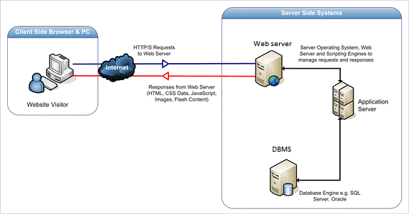
Web Server & Application Server
Notes:
Scenario 1: Web server without an application server
you have an online store with only a web server and no application server. The site will provide a display where you can choose a product from. When you submit a query, the site performs a lookup and returns an HTML result back to its client. The web server sends your query directly to the database server (be patient, I will explain this one in our next nugget) and waits for a response. Once received, the web server formulates the response into an HTML file and sends it to your web browser. This back and forth communication between the server and database server happens every time a query is run.
Scenario 2: Web server with an application server
if the query you want to run has already been done previously and no data has changed since then, the server will generate the results without having to send the request to the database server. This allows a real-time query where a second client can access the same info and receive real time, reliable information without sending another duplicate query to the database server. The server basically acts as an intermediate between the database server and the web server. This allows the information pulled to be reusable while in the first scenario, since this info is embedded in a particular and "customized" HTML page, this is not a reusable process. A second client will have to request the info again and receive another HTML embedded page with the info requested -highly inefficient. Not to mention that this type of server is very flexible due to its ability to manage its own resources, including security, transaction processing, messaging and resource pooling.

Slide 9
Web server
Web server mostly serve static files
Example of web server
  Apache web server
  IIS web server
  Nginx web server
  LightSpeed web server
Image File
Video File
Request file
Browser
Web Server
Audio File
Response file
Html File, Pdf,css , js

Slide 10
Application Server
Application server used to deploy application
Application should be created using java , .NET
Transactions
Security
Dependency
Injection
Concurrency
Connection Pooling
Object Pooling
Messaging services
Application Server
Applications
DB
Web
Server
Notes:
Web Server is designed to serve HTTP Content. App Server can also serve HTTP Content but is not limited to just HTTP. It can be provided other protocol support such as RMI/RPC
Web Server is mostly designed to serve static content, though most Web Servers have plugins to support scripting languages like Perl, PHP, ASP, JSP etc. through which these servers can generate dynamic HTTP content.
Most of the application servers have Web Server as integral part of them, that means App Server can do whatever Web Server is capable of. Additionally App Server have components and features to support Application level services such as Connection Pooling, Object Pooling, Transaction Support, Messaging services etc.
As web servers are well suited for static content and app servers for dynamic content, most of the production environments have web server acting as reverse proxy to app server. That means while servicing a page request, static contents (such as images/Static HTML) are served by web server that interprets the request. Using some kind of filtering technique (mostly extension of requested resource) web server identifies dynamic content request and transparently forwards to app server

Slide 11
Application Server
Examples
Jboss
Websphere
WebLogic
Application Server
Web Container
Servlet
JSP
JSF
Web Services
Application client container
DI
Security
EJB
JTA

Slide 12
What is Tomcat?
Tomcat is a Servlet container (Web server that interacts with Servlets) developed under the Jakarta Project of Apache Software Foundation
Tomcat implements the Servlet and the Java Server Pages (JSP) specifications of Sun Microsystems
Tomcat is an open-source, non commercial project
  Licensed under the Apache Software License
Tomcat is written in Java (OS independent)

Slide 13
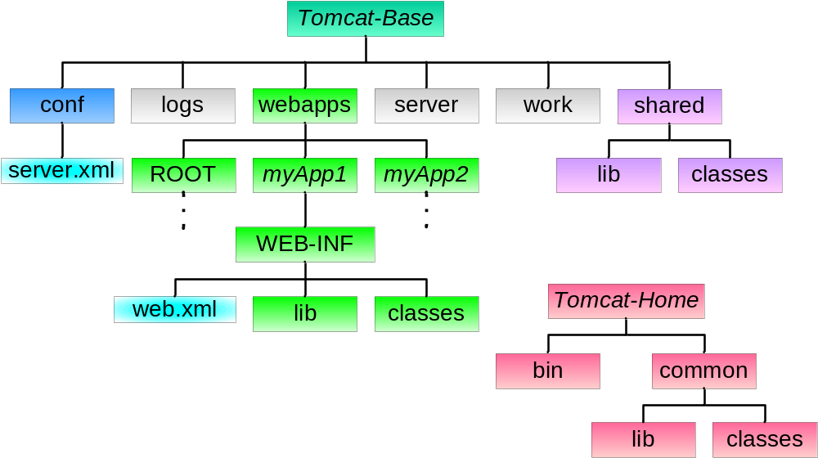

Tomcat Directory Structure

Slide 14


Introduction – request-response model
Request-response model.
HTTP
Request
request
Server
<html>
<head>
<body>
…
<html>
<head>
<body>
…
Client
response
HTTP
HTML

Slide 15
Introduction – what is a request and response
HTTP Request HTTP Response
Key elements of a “request”
stream:
HTTP method (action to be
performed).
The page to access (a URL).
Form parameters.
Key elements of a “response”
stream:
A status code (for whether
the request was successful).
Content-type (text, picture,
html, etc…).
The content ( the actual
content).

Slide 16
Introduction – What is a Servlet
Where does Servlet come into the picture?
I can serve only static HTML pages
Web Server
Application
Not a problem. I can handle dynamic requests.
Helper
Application
Web Server machine
“The Helper Application is nothing but a SERVLET”

Slide 17
Servlet Architecture -Web Container
What is a Web Container?
request
GET.
…..
GET.
…..
GET.
…..
Web
Server
Web
Container
Servlet
Client

Slide 18
Servlet Architecture – Web Container
How does the Container handle a request?
Servlet
Web
Container
request
Http request
response
Web
Server
Thread
response
<Html>
<Body>
…….
</Body>
</Html>
Service()
Client
doGet()

Slide 19
Servlet Architecture – Web Container
The CONTAINER
What is the role of Web Container ?
Communication Support
Lifecycle Management
Multi-threading support
Security
JSP Support
S2
S1
JSP1
S3
S4
The container can contain multiple Servlets & JSPs within it

Slide 20
Places where Servlets can be used
Accessed by name to generate a HTML page
Embedded inside a HTML page as a server side include
  These are useful when a web page is mostly static info but contains small sections of dynamically-generated info
Embedded inside a HTML page using Java Server Pages (JSP) – see these later

Slide 21
3 types of servlet engine
Standalone
  Server that contains built in support for Servlets (e.g. Tomcat)
    Does not exist for many web servers
  Disadvantage: have to wait for a new server release to get latest servlet support
Add-on
  A plug-in for an existing web server
  Many have been written for servers (e.g. Apache)
Embedded
  Lightweight servlet platform that can be embedded in another application

Slide 22
Advantages of Servlets
Servlets have 6 main advantages
  Efficient
  Convenient
  Powerful
  Portable
  Secure
  Inexpensive
Let us see why

Slide 23
Advantages of Servlets
Efficient
  For each browser request, the servlet spawns a light weight thread
  This is faster and more efficient than spawning a new operating system process
  Hence, servlets have better performance and scalability than traditional CGI

Slide 24
Advantages of Servlets
Convenient
  Servlets include built-in functionality for:
    Reading HTML from data
    Handling cookies
    Tracking user sessions
    Setting HTTP headers
  Java is an object-oriented language which arguably can make development easier

Slide 25
Advantages of Servlets
Powerful
  Servlets can talk directly to web servers
  Multiple servlets can share data
    Particularly important for maintaining database connections
  Includes powerful techniques for tracking user sessions

Slide 26
Advantages of Servlets
Portable
  One of the advantages of Java is its portability across different operating systems
  Servlets have the same advantages (they are written in Java)
    Can be written on a Windows platform and run on a UNIX operating system
  Servlets can be run on any Java-enabled web server with no code changes

Slide 27
Advantages of Servlets
Secure
  Traditional CGI programs have a number of known security vulnerabilities
  Hence, a separate CGI/Perl script is usually required to provide the extra security required
  Java itself has a number of built-in security features
  Therefore, Servlets are regarded to be more secure than CGI programs

Slide 28
Advantages of Servlets
Inexpensive
  You can download free servlet kits for development
  As many servlets that are required can be developed for free and run on many free Java-enabled web servers

Slide 29
Servlets Example
import javax.servlet.*;
import javax.servlet.http.*;
public class HelloWorld extends HttpServlet
{
public void doGet(HttpServletRequest request, HttpServletResponse response) throws
IOException, ServletException
{
response.setContentType("text/html");
PrintWriter out = response.getWriter();
out.println("<html>");
out.println("<body>");
out.println("<head>");
out.println("<title>Hello World!</title>");
out.println("</head>");
out.println("<body>");
out.println("<h1>Hello World!</h1>");
out.println("</body>");
out.println("</html>");
}
}

Slide 30
Servlet Architecture – Deployment Descriptor
How does the Container know which Servlet the client has requested for?
A Servlet can have 3 names
Client known URL name
Deployer known secret
internal name
Actual file name
<web-app>
………
<servlet>
<servlet-name>LoginServ</servlet-name>
<servlet-class>com.Login</servlet-class>
</servlet>
<servlet-mapping>
<servlet-name>LoginServ</servlet-name>
<url-pattern>/Logon</url-pattern>
</servlet-mapping>
………..
………..
</web-app>
Web.xml

Slide 31
Servlet Lifecycle
The Servlet lifecycle is simple, there is only one main state – “Initialized”.
Does not exist
constructor()
destroy()
init()
Initialized
Service()

Slide 32
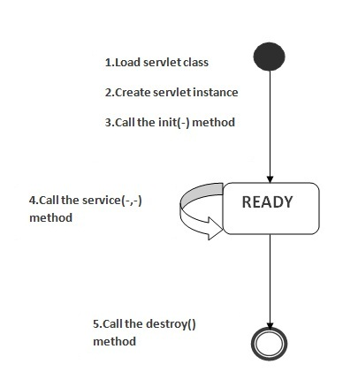
Life Cycle of a Servlet
The web container maintains the life cycle of a servlet instance. Let's see the life cycle of the servlet:
Servlet class is loaded.
Servlet instance is created.
init method is invoked.
service method is invoked.
destroy method is invoked.

Slide 33
Servlet class is loaded
  The class loader is responsible to load the servlet class. The servlet class is loaded when the first request for the servlet is received by the web container.
Servlet instance is created
  The web container creates the instance of a servlet after loading the servlet class. The servlet instance is created only once in the servlet life cycle.
init method is invoked
  The web container calls the init method only once after creating the servlet instance. The init method is used to initialize the servlet. It is the life cycle method of the javax.servlet.Servlet interface

Slide 34
service method is invoked
  The web container calls the service method each time when request for the servlet is received. If servlet is not initialized, it follows the first three steps as described above then calls the service method. If servlet is initialized, it calls the service method.
destroy method is invoked
  The web container calls the destroy method before removing the servlet instance from the service. It gives the servlet an opportunity to clean up any resource for example memory, thread etc.

Slide 35
HttpServlet class
The HttpServlet class extends the GenericServlet class and implements Serializable interface.
It provides http specific methods such as doGet, doPost, doHead, doTrace etc.

Slide 36
Servlet Lifecycle - Hierarchy
Interface
Servlet
Abstract class
GenericServlet
If not overridden, implements init()
method from the ‘Servlet’ interface,
Abstract class
HttpServlet
If not overridden, implements service()
method.
Concrete class
Your Servlet
We implement the HTTP methods
here.

Slide 37
HttpServlet Methods
public void service(ServletRequest req,ServletResponse res) dispatches the request to the protected service method by converting the request and response object into http type.
protected void service(HttpServletRequest req, HttpServletResponse res) receives the request from the service method, and dispatches the request to the doXXX() method depending on the incoming http request type.
protected void doGet(HttpServletRequest req, HttpServletResponse res) handles the GET request. It is invoked by the web container

Slide 38
protected void doPost(HttpServletRequest req, HttpServletResponse res) handles the POST request. It is invoked by the web container.
protected void doHead(HttpServletRequest req, HttpServletResponse res) handles the HEAD request. It is invoked by the web container.
protected void doOptions(HttpServletRequest req, HttpServletResponse res) handles the OPTIONS request. It is invoked by the web container.

Slide 39
protected void doPut(HttpServletRequest req, HttpServletResponse res) handles the PUT request. It is invoked by the web container.
protected void doTrace(HttpServletRequest req, HttpServletResponse res) handles the TRACE request. It is invoked by the web container.
protected void doDelete(HttpServletRequest req, HttpServletResponse res) handles the DELETE request. It is invoked by the web container.
protected long getLastModified(HttpServletRequest req) returns the time when HttpServletRequest was last modified since midnight January 1, 1970 GMT.

Slide 40
Servlet Lifecycle – 3 big moments
 | When is it called | What it’s for | Do you override it
init() | The container calls the init() before the servlet can service any client requests. | To initialize your servlet before handling any client requests. | Possibly
service() | When a new request for that servlet comes in. | To determine which HTTP method should be called. | No. Very unlikely
doGet() or doPost() | The service() method invokes it based on the HTTP method from the request. | To handle the business logic. | Always

Slide 41
Servlet Lifecycle – Thread handling
The Container runs multiple threads to process multiple requests to a single servlet.
Container
Client A
Client B
Servlet
Thread
A
Thread
B
response
request
request
response

Slide 42
Request and Response – GET v/s POST
The HTTP request method determines whether doGet() or doPost() runs.
 | GET (doGet()) | POST (doPost())
HTTP Request | The request contains only the request line and HTTP header. | Along with request line and header it also contains HTTP body.
Parameter passing | The form elements are passed to the server by appending at the end of the URL. | The form elements are passed in the body of the HTTP request.
Size | The parameter data is limited (the limit depends on the container) | Can send huge amount of data to the server.
Idempotency | GET is Idempotent | POST is not idempotent
Usage | Generally used to fetch some information from the host. | Generally used to process the sent data.

Slide 43
Request and Response – The response
Request
Does the Servlet know
Who can serve?
Can the Servlet
Serve the request?
No
No
Yes
Yes
Send Redirect
Send resource
Request Dispatcher
Error page

Slide 44
Being a Web Container – Servlet Config and Context
Servlet Context
JSP 1
Servlet 1
Servlet 2
Servlet 3
Servlet Config
Servlet Config
Servlet Config
Servlet Config

Slide 45
Being a Web Container – init parameters
What are init parameters?
Difference between Servlet Context and Config Init parameters
 | Context Init Parameters | Servlet Init Parameters
Scope | Scope is Web Container | Specific to Servlet or JSP
Servlet code | getServletContext() | getServletConfig()
Deployment Descriptor | Within the <web-app> element but not within a specific <servlet> element | Within the <servlet> element for each specific servlet

Slide 46
Being a Web Container - Attributes
What exactly, is an attribute?
Difference between Attributes and parameters
 | Attributes | Parameters
Types | Context Request Session | Context Request Servlet Init
Method to set | setAttribute(String, Object) | We cannot set Init parameters.
Return type | Object | String
Method to get | getAttribute(String) | getInitParameter (String)

Slide 47
Session Management – Session Tracking
new
How sessions work?
1
2
request, “dark”
ID# 42
“dark”
HttpSession
Client A
response, ID# 42
setAttribute(“dark”)
4
3
Container
ID# 42
“dark”
“ale”
#42
Client A
1
HttpSession
request, “ale”, ID# 42
2
Container

Slide 48

Session Tracking – Cookies
Here’s your cookie with session ID inside…
HttpSession session = request.getSession();
HTTP/1.1 200 OK
Set-Cookie: JSESSIONID=0ABS
Content-Type: text/html
Server: Apache-Coyote/1.1
<html>
…
</html>
Client A
OK, here’s the cookie with my request
Container
HTTP Response
POST / login.do HTTP/1.1
Cookie: JSESSIONID=0ABS
Accept: text/html……
Client A
HTTP Request
Container

Slide 49
Session Tracking – URL Rewriting
URL ;jsessionid=1234567
Container
HTTP/1.1 200 OK
Content-Type: text/html
Server: Apache-Coyote/1.1
<html>
<body>
< a href =“ http:// www.sharmanj.com/Metavante;jsessionid=0AAB”>
click me </a>
</html>
Client A
HTTP Response
GET /Metavante;jsessionid=0AAB
HTTP / 1.1
Host: www.sharmanj.com
Accept: text/html
Client A
HTTP Request
Container

Slide 50
JSP Overview - Servlets v/s JSPs
Servlets : HTML within Java
business logic
JSPs : Java within HTML
Presentation logic
public void doGet(request, response)
{
PrintWriter out = response.getWriter();
String name =
request.getParameter(name);
out.println(“<html><body>”);
out.println("Hello” + name);
out.println(“</body></html>”);
}
<html>
<body>
<% String name =
request.getParameter(name); %>
Hello <%= name %>
</body>
</html>

Slide 51
Request Dispatcher
The RequestDispatcher interface provides the facility of dispatching the request to another resource it may be html, servlet or jsp.
This interface can also be used to include the content of another resource also. It is one of the way of servlet collaboration.
public void forward(ServletRequest request,ServletResponse response)throws ServletException,java.io.IOException:Forwards a request from a servlet to another resource (servlet, JSP file, or HTML file) on the server.
public void include(ServletRequest request,ServletResponse response)throws ServletException,java.io.IOException:Includes the content of a resource (servlet, JSP page, or HTML file) in the response.

Slide 52
  How to create Cookie?
Cookie ck=new Cookie("user","sonoo jaiswal");//creating cookie object
response.addCookie(ck);//adding cookie in the response

Slide 53

JSP Overview - What is a JSP
In the end, a JSP is just a Servlet.
Is translated to
Compiles to
Is loaded and
Initialized as
writes
JSP
Import javax.
servlet.
HttpServlet.*
0010 0001
1100 1001
0001 0011
Servlet
MyJsp.jsp
MyJsp_jsp.java
MyJsp_jsp.class
MyJsp_jsp
Servlet

Slide 54
JSP Elements
Scriptlets
    <% int I = 10; %>
    <% Dog d = new Dog(); %>
Expressions
    <%= i %>
    <%= d.getName() %>
Declarations
    <%! int i=10; %>
    <%! void display() { System.out.println(“Hello”); } %>
Directives
    Pages - <%@ page import=“foo.*, bar.*” %>
    include - <%@ include file=“/foo/myJsp.jsp” %>
    taglib - <%@ taglib uri=“Tags” prefix=“cool” %>
= out.println(i);
= out.println(d.getName());

Slide 55
JSP Elements – JSP to Servlet
Where does the JSP code land in the Servlet?
<%@ page import=“foo.*” %>
<html>
<body>
<% int i = 10; %>
<%! int count = 0; %>
Hello! Welcome
<%! Public void display()
{
out.println(“Hello”);
} %>
</body>
</html>
import javax.servlet.HttpServlet.*
import foo.*;
public class MyJsp_jsp extends
HttpServlet
{
int count = 0;
public void display()
{
out.println(“Hello”);
}
public void _jspService(req, res)
{
int i = 0;
out.println(“<html>\r<body>”);
out.println(“Hello! Welcome”);
}
}

Slide 56

Q & A

